Slide 1
Interactive Large-Scale Data and Graph Analytics
Introduction
Oliver Alvarado Rodriguez, Naren Khatwani, Zhihui Du, David Bader

Slide 2


Slide 3
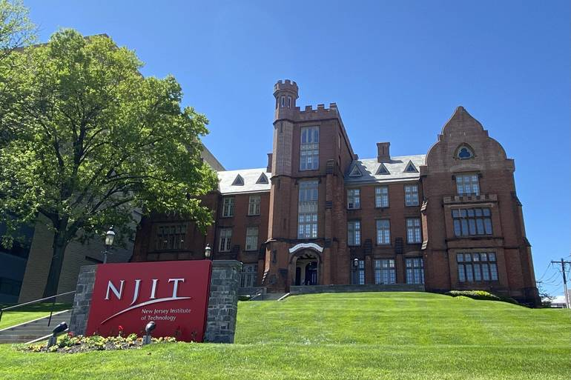
New Jersey Institute of Technology
“NJIT Climbs the Rankings of U.S. News & World Report, A Top 50 Public University” – 13 Sep 2021
“NJIT Named As One of Nation's 'Best Colleges' for 2022, The Princeton Review Says” – 6 Sep 2021

Slide 4

Center for Big Data
Big Data Analytics, Systems, and Tools
Cybersecurity Research Center
Practical encryption
The Structural Analysis of Biomedical Ontologies Center
Medical Informatics
NIH / National Cancer Institute
FinTech Group
Machine Learning & AI
Cyberinfrastructure
Privacy technologies
Information Assurance
Financial Services
Real-world technologies
Industrial partnerships
Insurance Industry
Launched in July 2019, with inaugural director David A. Bader
(~40 faculty in current centers)
Urban sustainability
Healthcare analytics
Trustworthy, Free and Fair Elections
Insider threat detection
Utility infrastructure protection
Cyberattack defense
Disease outbreak and epidemic monitoring
Solving real-world challenges

Slide 5
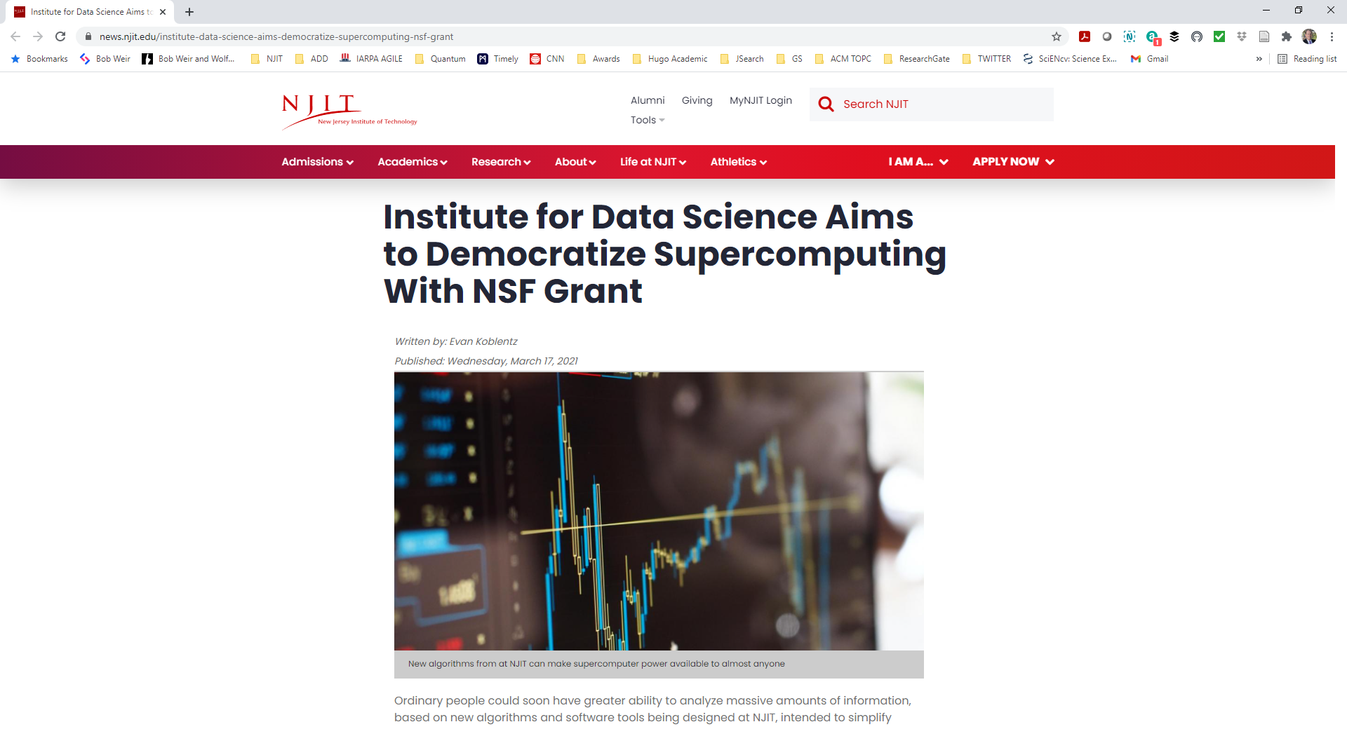

High Performance Algorithms for Interactive Data Science at Scale (PI: Bader) 3/2021 – 2/2023 NSF CCF-2109988
https://news.njit.edu/institute-data-science-aims-democratize-supercomputing-nsf-grant

Slide 6
Publications
Oliver Alvarado Rodriguez, Zhihui Du, Joseph Patchett, Fuhuan Li, David Bader (2022). Arachne: An Arkouda Package for Large-Scale Graph Analytics. IEEE HPEC.
Zhihui Du, Joseph Patchett, Oliver Alvarado Rodriguez, Fuhuan Li, David Bader (2022). High-Performance Truss Analysis in Arkouda. IEEE HiPC.
Joseph Patchett, Zhihui Du, Fuhuan Li, David Bader (2022). Triangle Centrality in Arkouda. IEEE HPEC.
Zhihui Du, Oliver Alvarado Rodriguez, David Bader (2021). Large Scale String Analytics In Arkouda. IEEE HPEC.
Zhihui Du, Oliver Alvarado Rodriguez, David Bader (2021). Enabling Exploratory Large Scale Graph Analytics through Arkouda. IEEE HPEC.
Joseph Patchett, Zhihui Du, David Bader (2021). K-Truss Implementation in Arkouda (Extended Abstract). IEEE HPEC.
Zhihui Du, Oliver Alvarado Rodriguez, Joseph Patchett, David Bader (2021). Interactive Graph Stream Analytics in Arkouda. Algorithms.
Zhihui Du, Oliver Alvarado Rodriguez, David A. Bader, Michael Merrill, William Reus (2021). Exploratory Large Scale Graph Analytics in Arkouda. CHIUW.
Notes:
Bolded on can be considered our “launch” paper.

Slide 7
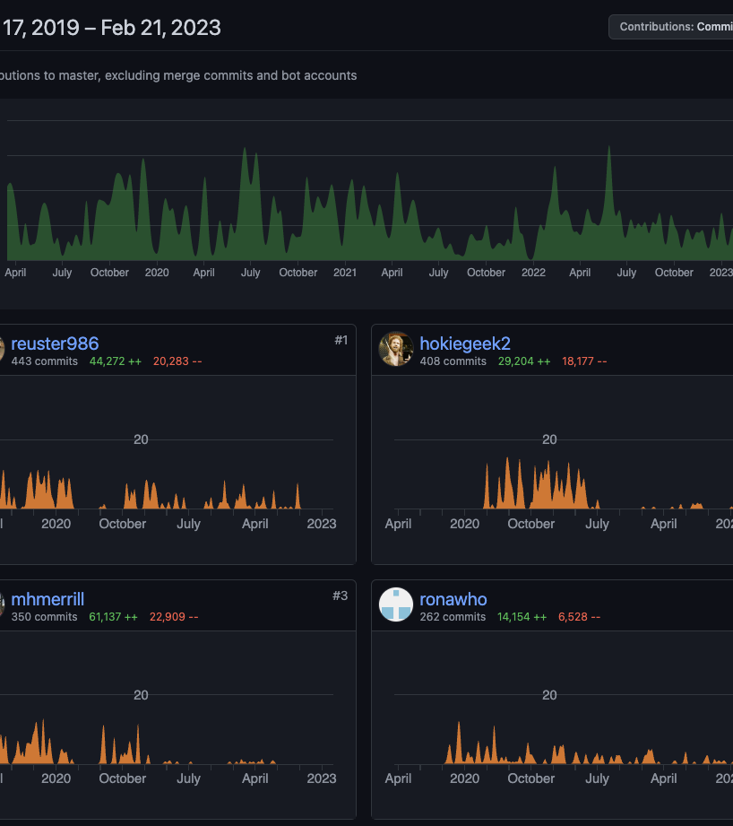
Arkouda Founders & Contributors
Main Founders:
Michael Merrill – US government
William Reus – US government
Main Contributors:
https://github.com/Bears-R-Us/arkouda/graphs/contributors
Notes:
Bill Reus biography: HPC data scientist with 10 years of experience, seeking to solve world-class problems via thoughtful application of computational statistics. Achievements include marshaling massive computational resources to counter terrorist organizations and develop new sources of key insight for US policymakers. Highly skilled in creative problem solving, parallel programming, and compelling communication of results.

Slide 8
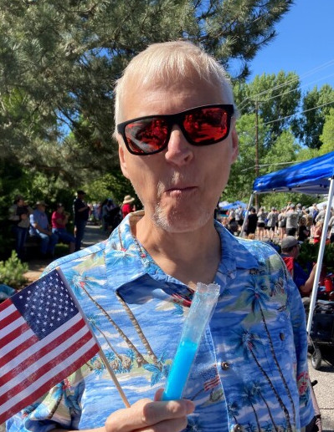
Arkouda: Dedication to Michael H. Merrill (June 2, 1964 ~ November 8, 2022)
“Mike was a dedicated civil servant. He was a Computer Scientist at the Department of Defense for 34 years and was recognized in 2022 with a Distinguished Civilian Service Medal. He loved computers and technology, especially high performance computing. Mike was a problem solver and innovative thinker; he was recognized for inspiring and leading numerous large projects over the course of his career. He loved to share his knowledge and mentored many colleagues over the years—sometimes calling them his kids, sometimes his minions, but always calling them his friend.”

Slide 9
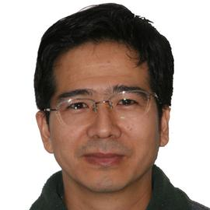

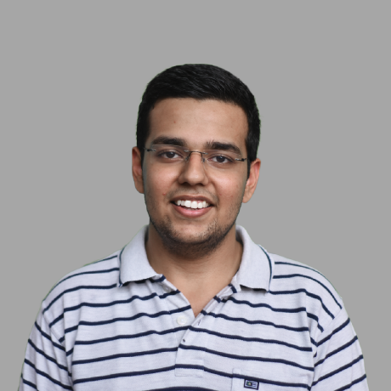
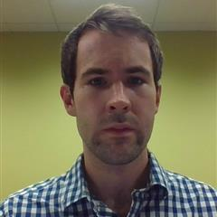



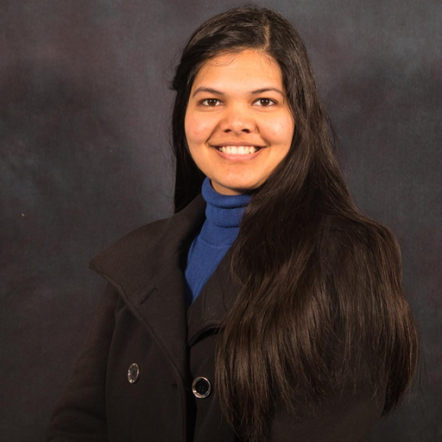
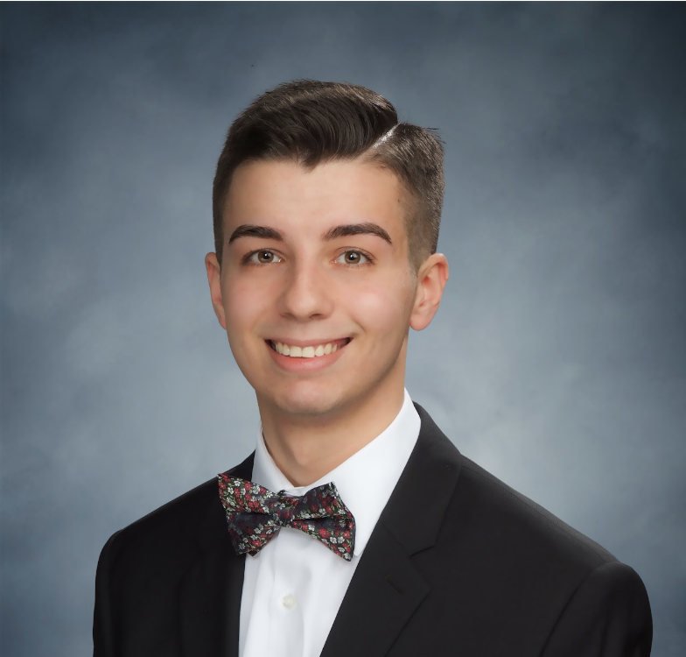
Arachne Developers
Zhihui Du
Research Scientist
Oliver Alvarado Rodriguez
PhD Candidate
Naren Khatwani
MS student
Joseph Patchett
MS student (grad)
David Bader
Distinguished Professor
Fuhuan Li
PhD Student
Rajendra Prasad Patil
MS Student (grad)
Vanshika Agrawal
Undergrad Student
Dave Petrovikj
Undergrad Student

Slide 10
Motivation 1: Massive-Scale Real-World Graphs
Public Health → epidemic/pandemic contact tracing networks (COVID-19, monkey pox, flu(s))
Sociology → massive social media networks, email communication networks
Bioinformatics → protein and genome networks
Neuroscience → brain connectivity networks
Urban Planning → electrical power grid networks
Scientometrics → co-authorship networks
Finance → transaction networks

Slide 11
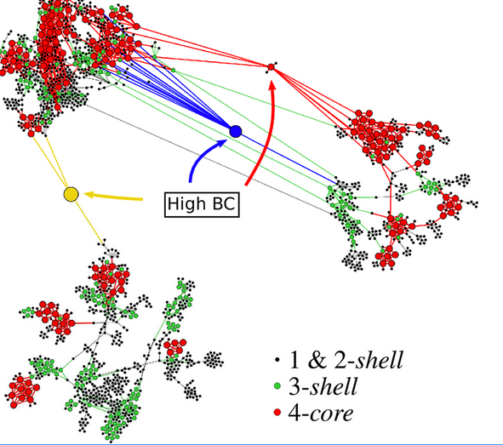
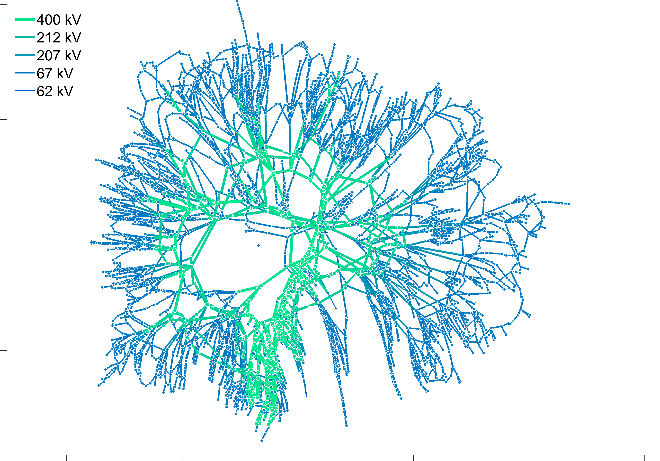
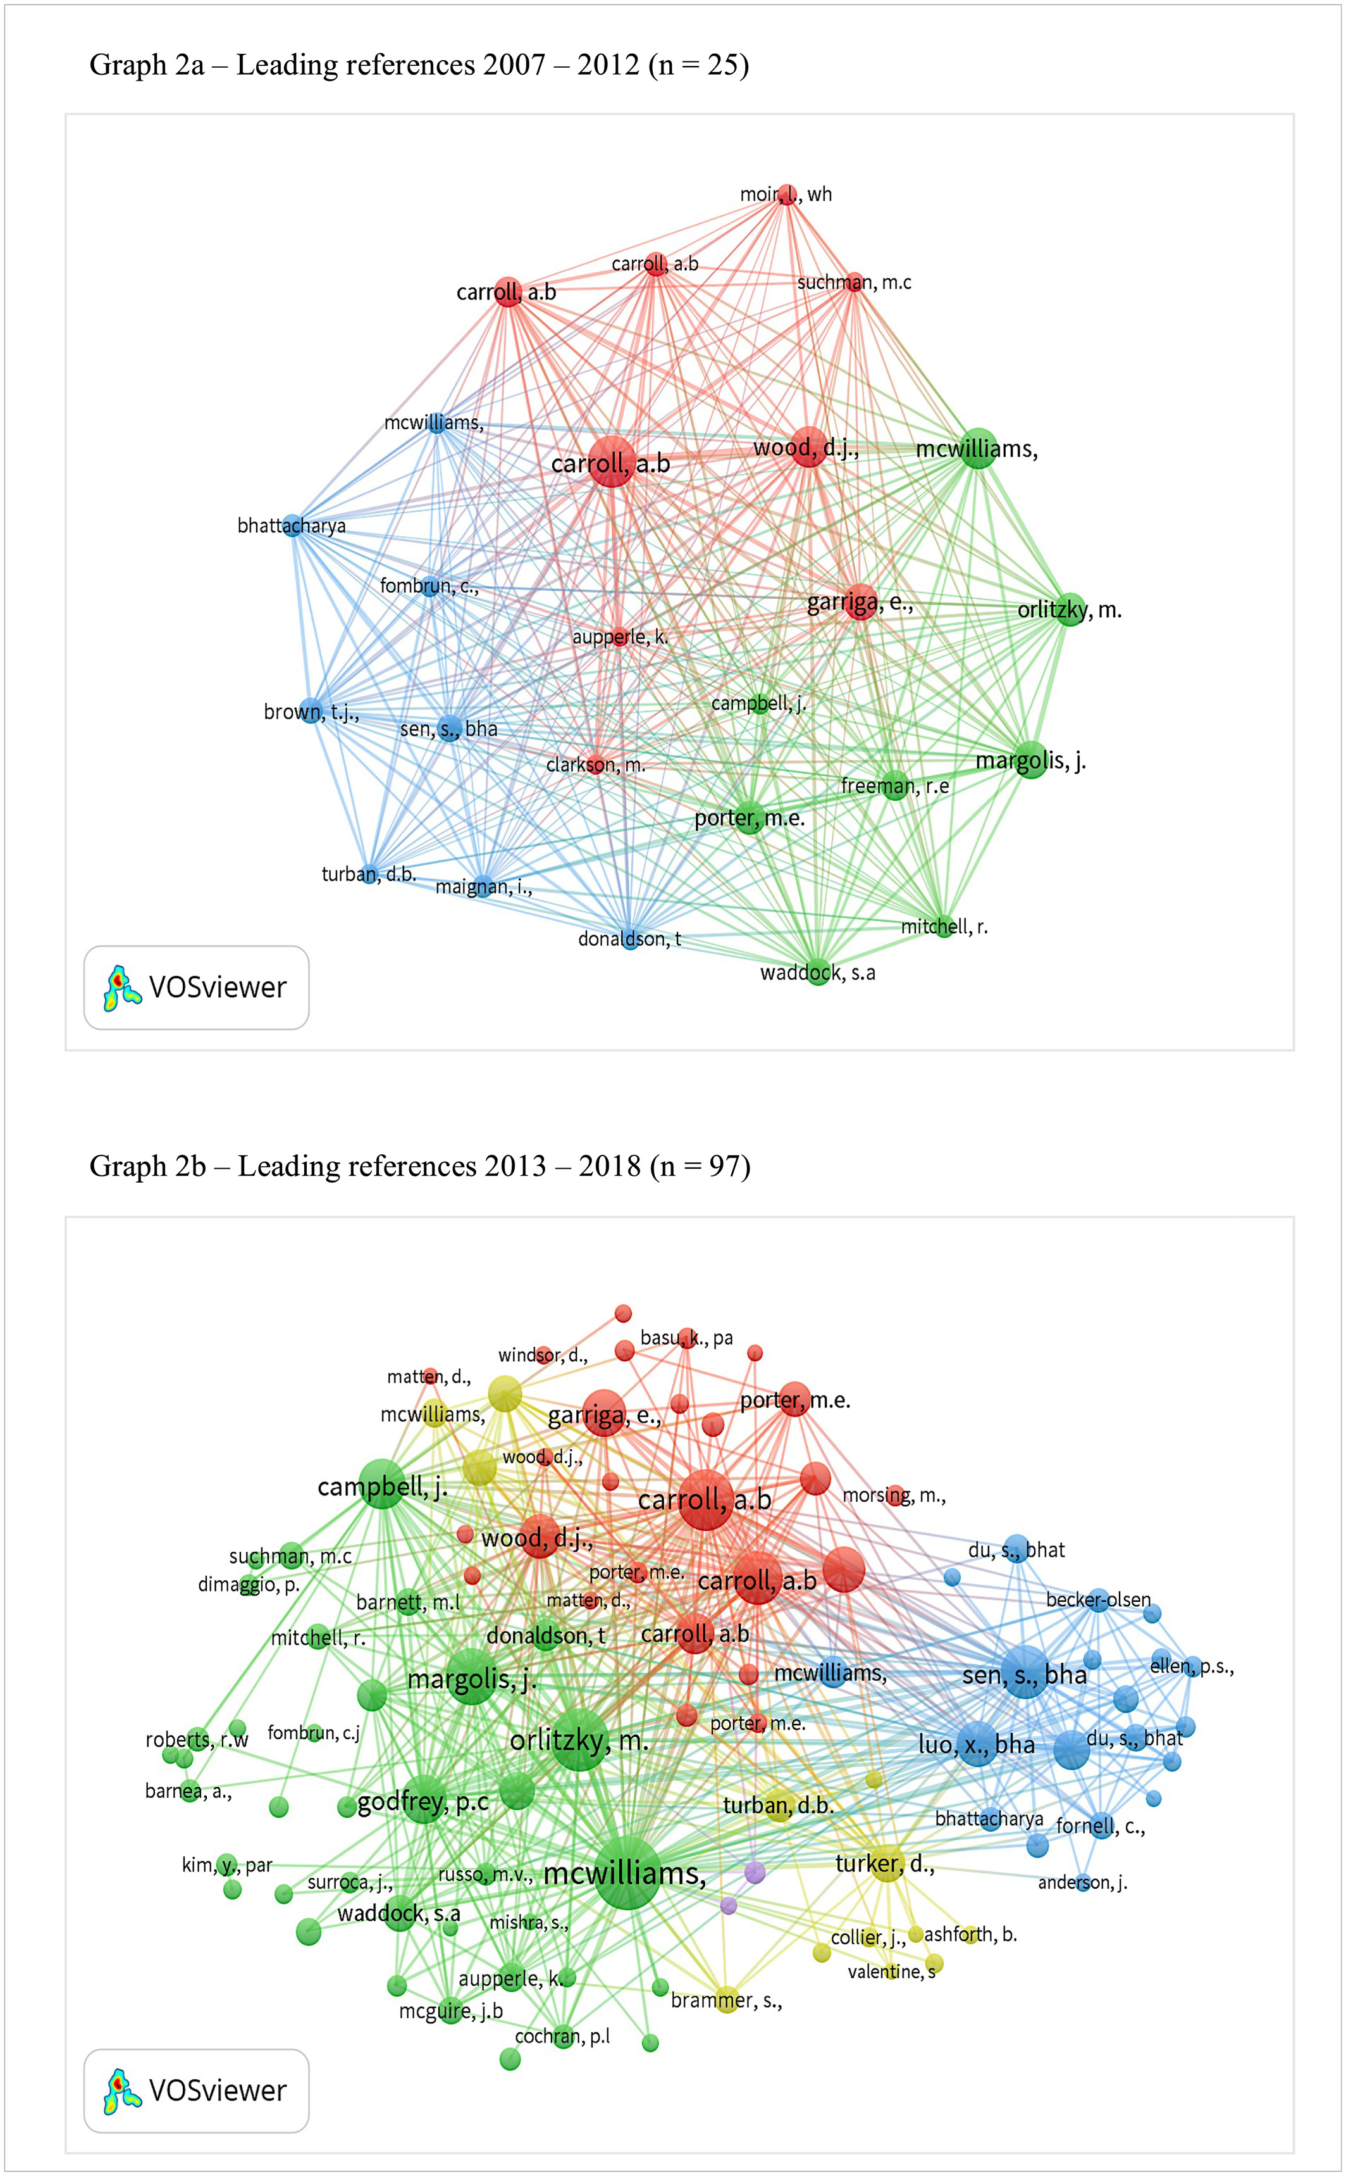
Motivation 2: Need for Graph Analytics
Analyzed infection network of COVID to find vertices with high betweenness centrality values that signified a super-spreader between communities [Serafino, Monteiro, et al. 2022].
Visualization of a high voltage transmission system to find the edges with maximum flow [Cuffe, 2016].
Finding the communities amongst authors in the area of corporate social responsibility [Ferramosca, Verona, 2019].

Slide 12
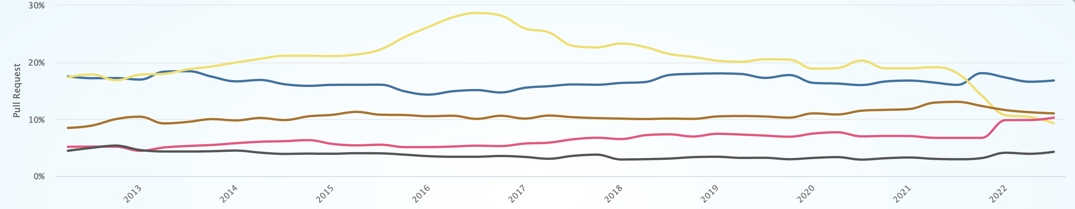
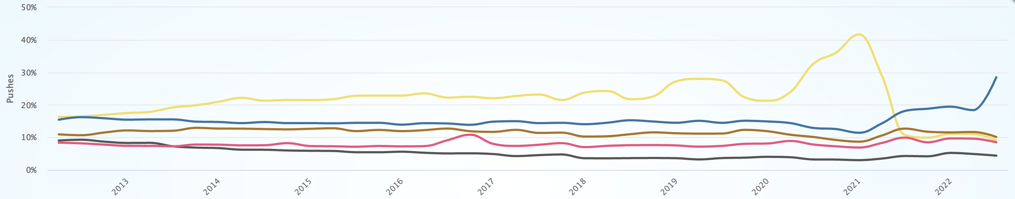
Motivation 3: Growing Usage of Python for Productive Computing
Pull Requests
C --- C++ --- Java --- Javascript --- Python ---
Pushes
https://madnight.github.io/githut/#/pull_requests/2022/3

Slide 13
Motivations Overlap
we need insights from huge graphs
IMMENSITY
ANALYTICS
massive-scale real-world graphs
need for graph analytics
???
we fail to analyze massive graphs with Python
growing usage of Python for computing sciences
Python is the leading language for analysis
PRODUCTIVITY
Notes:
Red and blue → more Python = more failed analysis of large graphs
Red and yellow → a lot problems can be solved through graph analysis
Blue and yellow → we have a lot of problems to solve, and we want to solve them through Python
Efficiently, effectively, and productively

Slide 14
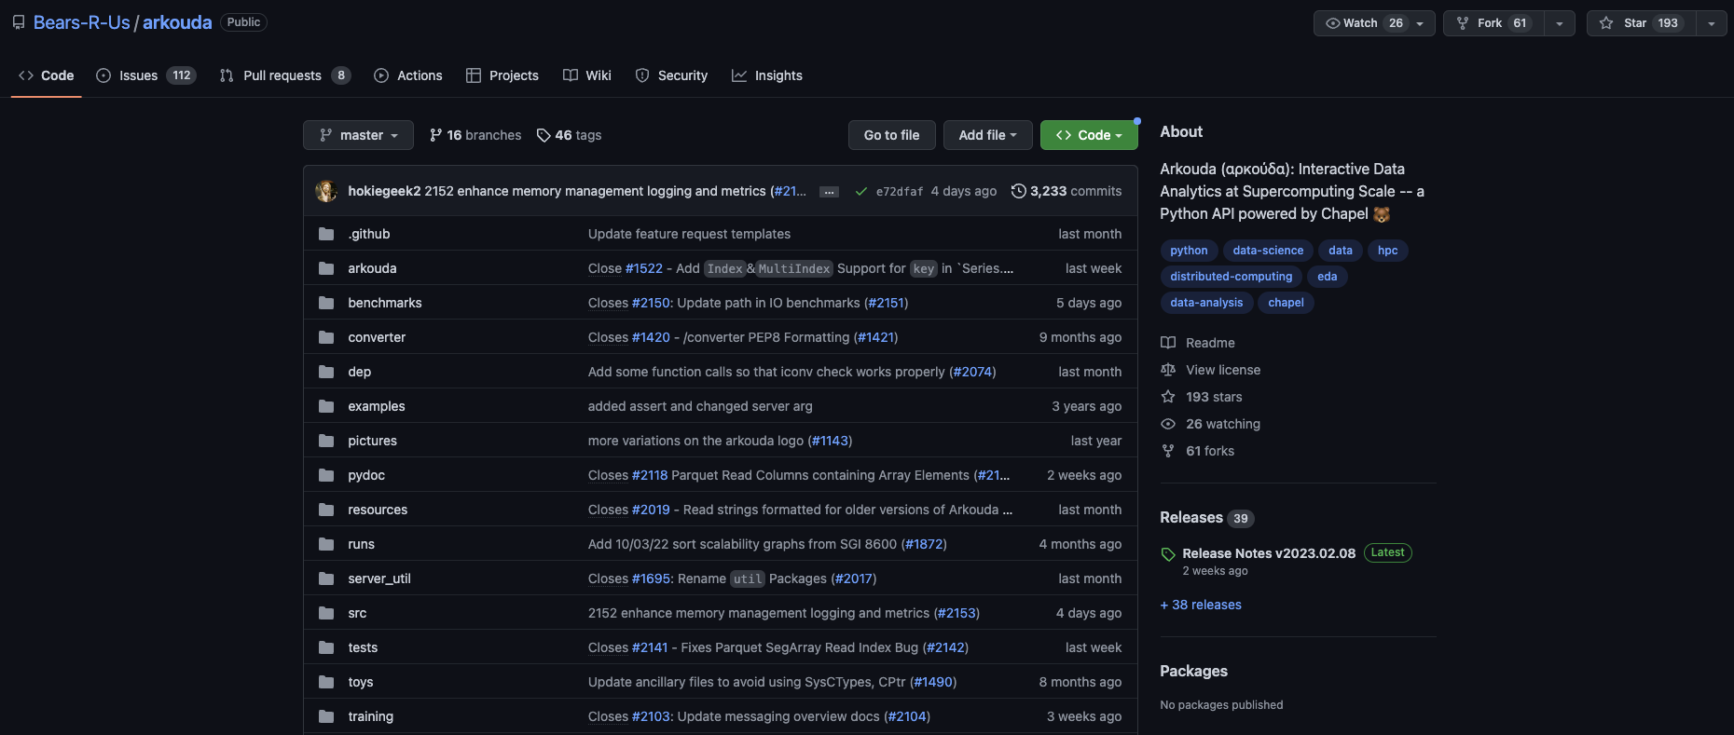
Arkouda: Interactive Data Analytics at Supercomputing Scale
https://github.com/Bears-R-Us/arkouda
Notes:
UPDATE IMAGE BEFORE PRESENTATION

Slide 15
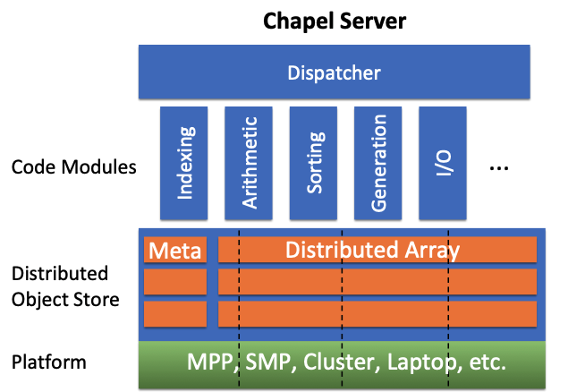

The Arkouda Framework with Arachne
Chapel Server
Jupyter
Or
Python3
Code
ZMQ
Overarching Dispatcher
Arachne
BFS
CC
K-Truss
…
Meta
Distributed Array
MPP, SMP, Cluster, Laptop, etc.
Arachne is built as an add-on with Arkouda and is fully interoperable.
Written in Chapel (productive & high-performance parallel programming language).
Image source: https://chapel-lang.org/CHIUW/2020/Reus.pdf

Slide 16
Arachne Infrastructure
Arachne Essential
Arachne Core
breadth-first search
connected components
triangle counting
triangle centrality
estimated triangle counting
truss analytics
jaccard coefficients
file reading
creating graph from arrays
read in a file sketch
preprocess a graph
DI
file
pdarray | integer
query
benchmarks
timings across trials | correctness
edge | vertex arrays

Slide 17
How to use Arkouda and/or Arachne?
Use a Docker image.
Building from source. Works for both Arkouda and/or Arachne.

Slide 18
Using Arkouda from Docker
Install the lates version of Docker for Windows/MacOS/Linux.
Start Docker on your system.
Clone the Arkouda repository from (github.com/Bears-R-Us/arkouda) if you haven't already done so.
Install the environment for Arkouda into an Anaconda environment.
Run the command below to launch an Arkouda container with a mounted directory (github.com/Bears-R-Us/arkouda-contrib/tree/main/arkouda-docker).
# set env variables
export ARKOUDA_IMAGE_REPO=bearsrus
export ARKOUDA_VERSION=v2022.11.17
docker run -it --rm -p 5555:5555 --mount type=bind,source=/path/to/arkouda/resources/hdf5-testing,target=/app
$ARKOUDA_IMAGE_REPO/arkouda-smp-server:$ARKOUDA_VERSION

Slide 19
Building Arkouda and Arachne together from Source
Download and Build Chapel (chapel-lang.org/download.html).
Download Arkouda (github.com/Bears-R-Us/arkouda).
Download Arachne (github.com/alvaradoo/arkouda-contrib/tree/main/arachne).
That is the temporary location for Arachne, will be moving into arkouda-contrib maintained by the developers.
Follow the installation steps (github.com/alvaradoo/arkouda-contrib#installation)
Run the Arkouda server! (github.com/Bears-R-Us/arkouda#running-arkouda_server-toc)

Slide 20
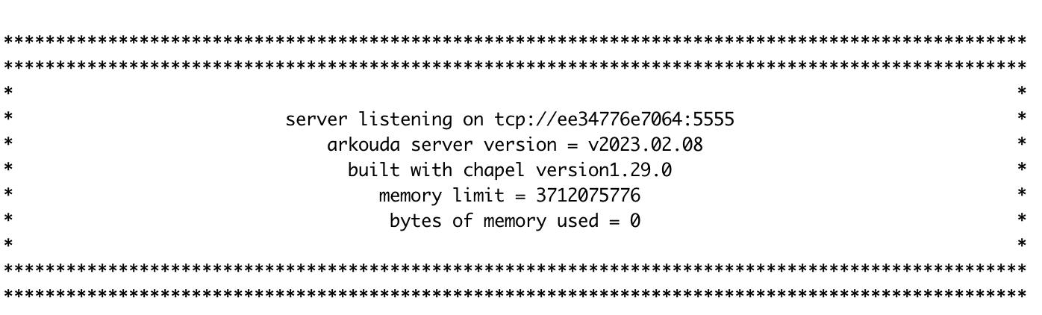
How the Arkouda Server Looks Like

Slide 21
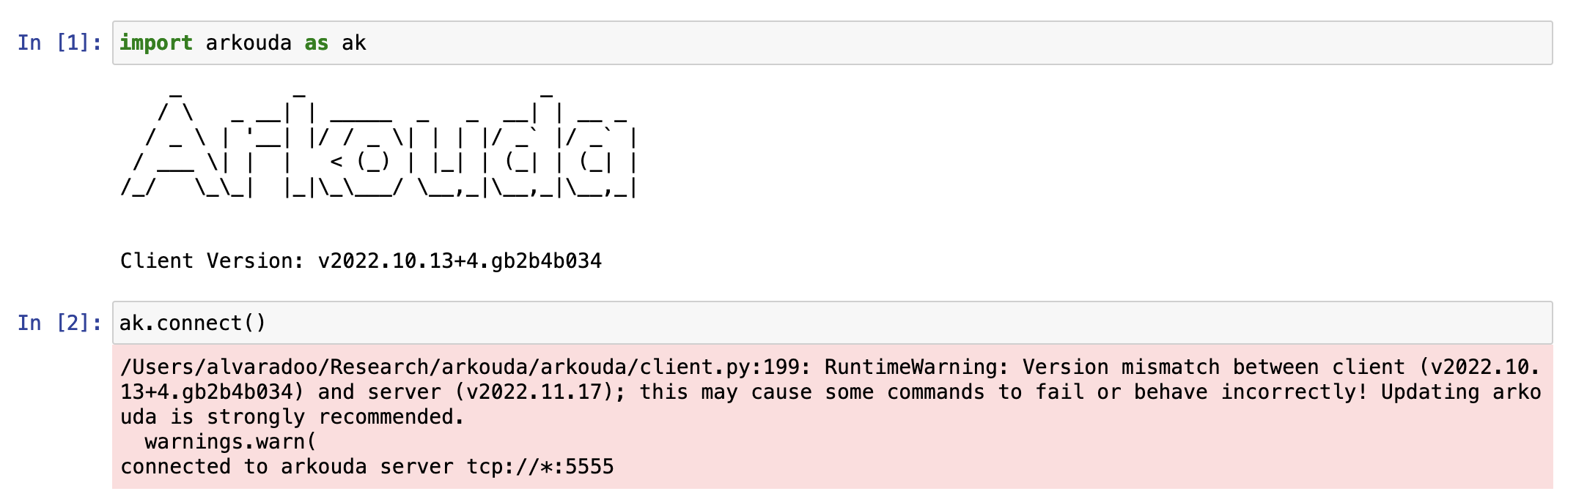
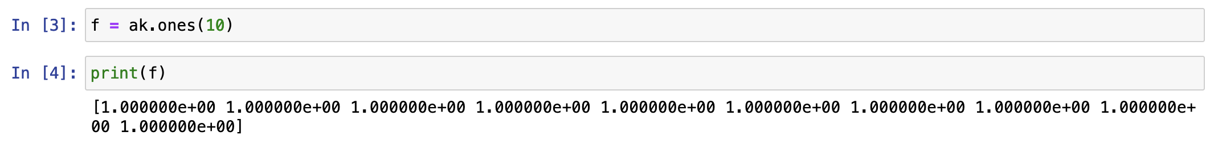
Connecting to Arkouda Server & Run Small Example

Slide 22
Thank You ☺ Questions?

